Slide 1
Object Detection using Convolution Neural Network
SPPNET & Fast RCNN

Slide 2

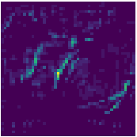
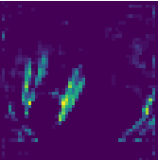
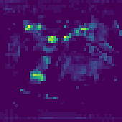

Object Detection – RCNN – Region Proposal Based CNN – Drawback
Part 1
Fc1
Fine Tuning on Region Proposals using log loss [SOFTMAX]
(Training Only)
Fc2
Stage 1
Classical CV
Stage 2
CNN
Part 2
Fc1
Classification
Score Using
Linear SVM per class
MODEL
Fc2
Region Proposals
VGG 16
C + 1 Class
Training
+
Testing
SS / EB
Feature Map
~ 2 K
Proposals
Fc1
Part 3
Classification and Localization Model
Bbox Regression
Cropping +
Warping
Process 2,000 region proposals individually by CNN (Don’t share CNN computational resource).

Slide 3
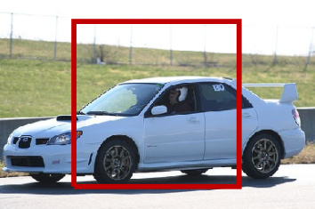
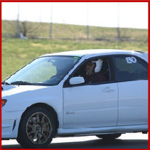
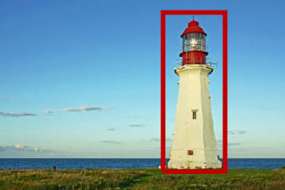

Object Detection – RCNN – Region Proposal Based CNN – Drawback
~ 2 K
Proposals
Region Proposals
Part 1
SS / EB
Fc1
Fine Tuning on Region Proposals using log loss [SOFTMAX]
(Training Only)
Fc2
Warping
ROI
Part 2
Fc1
Classification
Score Using
Linear SVM per class
MODEL
Fc2
VGG 16
C + 1 Class
Training
+
Testing
Feature Map
Fc1
Part 3
Crop
Classification and Localization Model
Bbox Regression
Warp
Process 2,000 region proposals individually by CNN (Don’t share CNN computational resource).
Warping distorts the geometry of the objects. Which may reduce the overall accuracy

Slide 4
Object Detection – RCNN – Region Proposal Based CNN – Drawback
~ 2 K
Proposals
Region Proposals
Part 1
SS / EB
Fc1
Fine Tuning on Region Proposals using log loss [SOFTMAX]
(Training Only)
Fc2
Warping
ROI
Part 2
Fc1
Classification
Score Using
Linear SVM per class
MODEL
Fc2
VGG 16
C + 1 Class
Training
+
Testing
Feature Map
Fc1
Part 3
Crop
Classification and Localization Model
Bbox Regression
Warp
How to Project or translate ROI proposals to feature maps ?
Alternative of Warping ?
Spatial pyramid pooling

Slide 5
Follow up Contents
SPPNET
Spatial pyramid pooling
Fast RCNN
CNN + Classical Based Region Proposal Paradigm
Perquisite
Drawbacks and Failure Cases of RCNN

Slide 6


Alternative of Warping ?
What will happen if we don’t warp the image ?
Constrain of CNN
2352
SOFTMAX
FC1
12
x
MAX Pool
Resize
5 x 5 x 3
2 x 2
34 x 34 x 3
30 x 30 x 12
15 x 15 x 12
2352
2352
8 Class
Convnet as FC
SOFTMAX
12
x
MAX Pool
2352
x
8
x
5 x 5 x 3
2 x 2
14 x 14
1 x 1
1 x 1 x 8
28 x 28 x 12
14 x 14 x 12
1 x 1 x 2352
32 x 32 x 3
8 Class

Slide 7
Alternative of Warping ?
Convnet as FC
4 Class
SOFTMAX
12
x
4
x
MAX Pool
3 x 3
5 x 5 x 3
2 x 2
s = 1
p = 0
2 x 2
12 x 12 x 3
8 x 8 x 12
4 x 4 x 12
2 x 2 x 4
Spatial Output
FC as convnets can be used even if we have varying image size but it gives spatial output.
Spatial outputs is requires when we have to find or localize the Bbox but Selective Search is already giving us the cropped ROI proposals as Bbox which need only finetuning.
Selective Search Crops
Spatial Pyramid Pooling

Slide 8
Alternative of Warping ? - Spatial Pyramid Pooling
Histogram of Images
0 | 0 | 0 | 255 | 255 | 255
0 | 0 | 0 | 255 | 255 | 255
0 | 0 | 0 | 255 | 255 | 255
0 | 0 | 0 | 255 | 255 | 255
0 | 0 | 0 | 255 | 255 | 255
0 | 0 | 0 | 255 | 255 | 255
1.0
36
1.0
36
0.5
18
0.5
18
6 x 6
0
1
-
-
-
-
-
-
-
255
0 - 49
50 - 99
100 - 149
150 - 199
200 - 255
255 | 255 | 255 | 255 | 255 | 255
255 | 255 | 255 | 255 | 255 | 255
255 | 255 | 255 | 255 | 255 | 255
0 | 0 | 0 | 0 | 0 | 0
0 | 0 | 0 | 0 | 0 | 0
0 | 0 | 0 | 0 | 0 | 0
255 | 255 | 255 | 0 | 0 | 0
255 | 255 | 255 | 0 | 0 | 0
255 | 255 | 255 | 0 | 0 | 0
255 | 255 | 255 | 0 | 0 | 0
255 | 255 | 255 | 0 | 0 | 0
255 | 255 | 255 | 0 | 0 | 0
Codebook | Bin | Count
0 - 49 | 0 | 18
49 - 99 | 1 | 0
99 - 149 | 2 | 0
150 - 199 | 3 | 0
200 - 255 | 4 | 18
Number of unique Feature
Credit: https://www.youtube.com/watch?v=bMcYkHSj7Qc&list=PL1GQaVhO4f_jLxOokW7CS5kY_J1t1T17S&index=67&ab_channel=Cogneethi

Slide 9


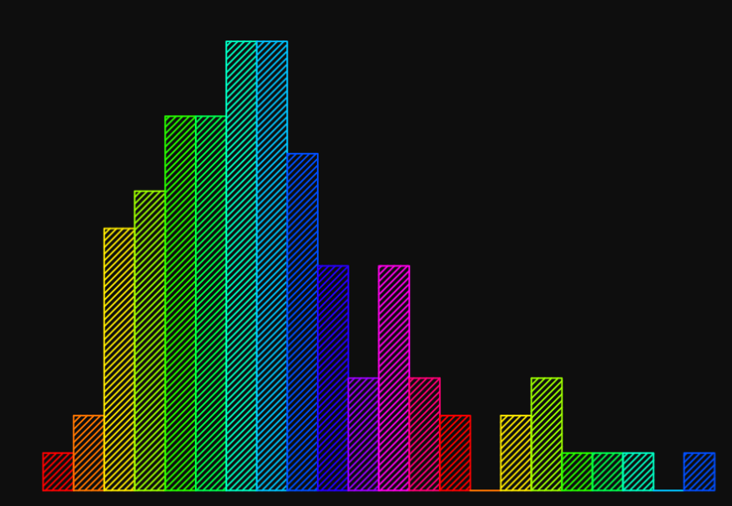
Alternative of Warping ? - Spatial Pyramid Pooling
Histogram of Images
Codebook | Bin | Count
0 - 49 | 0 | -
49 - 99 | 1 | -
99 - 149 | 2 | -
150 - 199 | 3 | -
200 - 255 | 4 | -
Cat
Dog
Number of unique Feature
≠
Codebook | Bin | Count
- | 0 | -
- | 1 | -
- | 2 | -
- | 3 | -
- | 4 | -
≈
Use SIFT of HOG ?
HOI
HOI

Slide 10
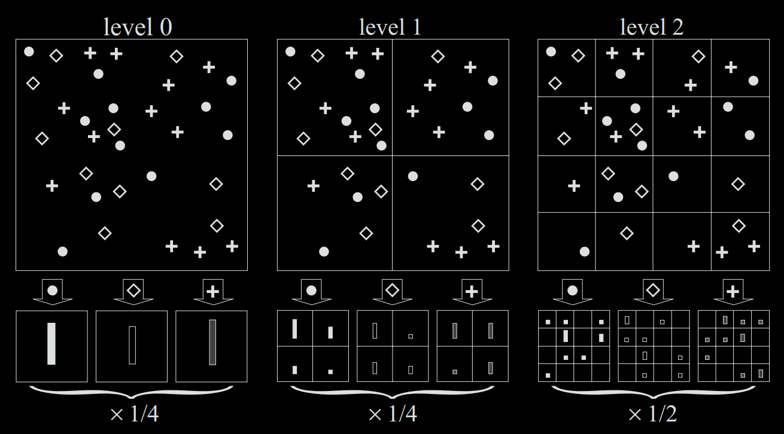



Alternative of Warping ? - Spatial Pyramid Pooling
Spatial Pyramid Matching
Codebook | Bin | Count
 | 0 | -
 | 1 | -
 | 2 | -
Number of Unique Features
1 x 1
2 x 2
4 x 4
X 3
21
Credit: https://ieeexplore.ieee.org/abstract/document/1641019

Slide 11
Alternative of Warping ? - Spatial Pyramid Pooling
Image Size
Spatial Pyramid Matching
Advantage
Fixed size output for any size/scale of image.
64 x 64
21 X 3
224 x 224
21 X 3

Slide 12


Alternative of Warping ? - Spatial Pyramid Pooling
Spatial Pyramid Matching
1.0
Feature Extract
0.5
0 - 49
50 - 99
100 - 149
150 - 199
200 - 255
Spatial Pyramid Matching
HOI
21 X 3
≠
≈
≠
1.0
0.5
Feature Extract
≠
0 - 49
50 - 99
100 - 149
150 - 199
200 - 255
Spatial Pyramid Matching
HOI
21 X 3

Slide 13
Alternative of Warping ? - Spatial Pyramid Pooling
Spatial Pyramid Matching
Feature Extract
HOI
Spatial Pyramid Matching
21 X 3
≠
≈
≠
Feature Extract
≠
Spatial Pyramid Matching
21 X 3
HOI

Slide 14
Alternative of Warping ? - Spatial Pyramid Pooling
Spatial Pyramid Pooling
How to use Spatial Pyramid Matching approach in CNN ?
CNN
Level 0
1 x 1
Feature Map
3 X 3
3 X 3
MAXPOOL
10 X 10
8 X 8
Level 1
2 x 2
12 X 12
Level 2
4 x 4
21 X 1

Slide 15
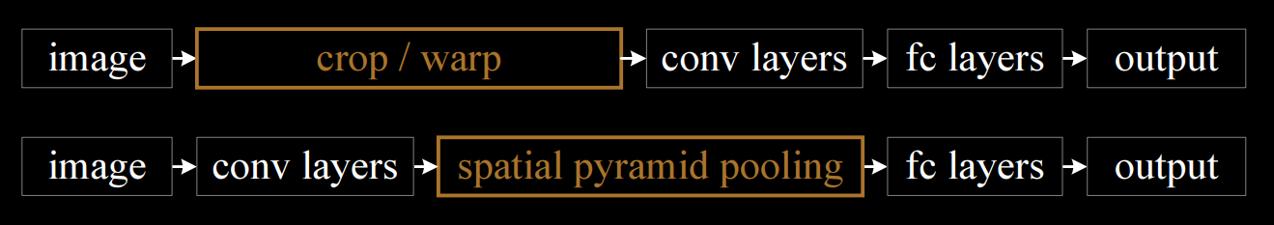
Alternative of Warping - Spatial Pyramid Pooling
Selective Search Crops
Constrain
CNN
Spatial Pyramid Pooling
Feature Map
21 x channel
Fixed size output for any size/scale of image.
CNN
Spatial Pyramid Pooling
Feature Map
21 x depth
depth ?

Slide 16
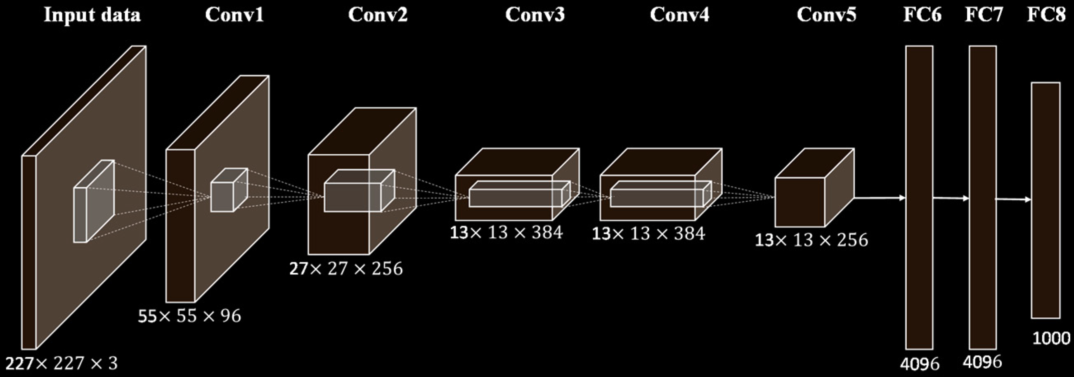
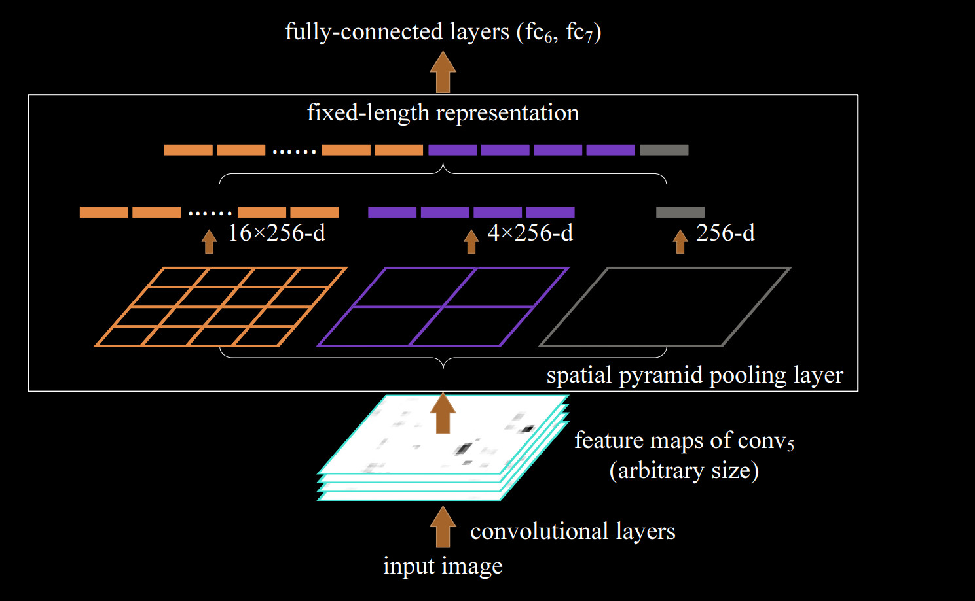
Alternative of Warping - Spatial Pyramid Pooling
AlexNET
For AlexNET
13 x 13 x 256
Credit: https://arxiv.org/abs/1406.4729

Slide 17
Spatial Pyramid Pooling Network – SPPNET
SPPNET for classification
ILSVRC 2014 : # 3rd Ranked
For AlexNET
13 x 13 x 256
Performance Increase : 1.5 % – 2 %
FC6
FC7
-
-
-
-
-
-
-
-
SOFTMAX
MODEL
VGG 16
Spatial Pyramid Pooling
C + 1 Class
Input Image
256
Feature Map
Classification Network
SPP has several remarkable properties for deep CNNs:
SPP is able to generate a fixed length output regardless of the input size.
Multi-level pooling has been shown to be robust to object deformations .
SPP can pool features extracted at variable scales thanks to the flexibility of input scales.
21 x 256
Replace last pool layer with SPP
Fixed size output

Slide 18
Spatial Pyramid Pooling Network – Experiment Findings
SPPNET for classification
Dataset – ImageNet 1000 class
Performance Increase : 1.5 % – 2 %
Multi Scale Training
Testing
Image scale 1 - 224 x 224
Image scale 2 - 180 x 180
Image scale – Fixed 224x224
4 level SPP – 1x1 , 2x2 , 3x3 , 6x6
Single Scale Training
Testing
Image scale - 224 x 224
Image scale – Flexible scale
4 level SPP – 1x1 , 2x2 , 3x3 , 6x6

Slide 19
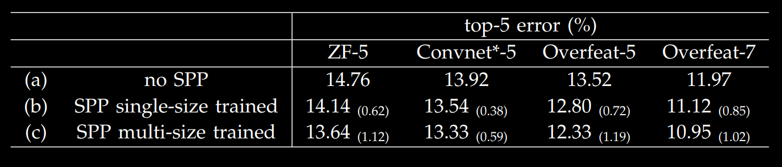
Spatial Pyramid Pooling Network – Experiment Findings
Proving the efficiency of SPP Only
SPPNET for classification
Using SPP with fixed input size and already existed network architecture also able to improve the performance.
Therefore, concluded that SPP is robust to object deformation even if fixed sized input the used only.
Credit: Spatial Pyramid Pooling in Deep Convolutional Networks for Visual Recognition

Slide 20
Spatial Pyramid Pooling Network for Object Detection
~ 2 K
Proposals
Region Proposals
Part 1
SS / EB
Fc1
Fine Tuning on Region Proposals using log loss [SOFTMAX]
(Training Only)
Fc2
Warping
ROI
Part 2
Fc1
Classification
Score Using
Linear SVM per class
MODEL
Fc2
VGG 16
C + 1 Class
Spatial Pyramid Pooling
Training
+
Testing
Feature Map
Fc1
Part 3
Crop
Classification and Localization Model
Bbox Regression
Warp

Slide 21
Spatial Pyramid Pooling Network for Object Detection
~ 2 K
Proposals
Region Proposals
Part 1
SS / EB
Fc1
Fine Tuning on Region Proposals using log loss [SOFTMAX]
(Training Only)
Fc2
ROI
Part 2
Fc1
Classification
Score Using
Linear SVM per class
MODEL
Fc2
VGG 16
C + 1 Class
Spatial Pyramid Pooling
Training
+
Testing
Feature Map
Fc1
Part 3
Crop
Classification and Localization Model
Bbox Regression
Warp
How to Project or translate ROI proposals onto feature maps ?
Alternative of Warping ?
Spatial pyramid pooling

Slide 22
Spatial Pyramid Pooling Network for Object Detection
How to Project or translate ROI proposals onto feature maps ?
~ 2 K
Proposals
Region Proposals
SS / EB
ROI
.
MODEL
VGG 16
C + 1 Class
Feature Map
Classification and Localization Model

Slide 23
Subsampling Ratio
18 x 18
3 X 3 Pool
3 X 3 Pool
2 X 2 Pool
Stride = 3
Stride = 3
Stride = 2
6x6
2x2
1x1
Subsampling Ration = 18
18 x 18
3 X 3 Pool
3 X 3 Pool
2 X 2 Pool
Stride = 3
Stride = 1
Stride = 2
6x6
3x3
3x3
Subsampling Ration = 6
Feature Map
MODEL
221 x 221
x
channel
13 x 13 x depth
Subsampling Ration = 17
Note: Subsampling ratio doesn’t depend on depth and channel.

Slide 24
ROI Projection
w₁
x₁
y₁
h₁
w₁
.
h₁
x₁ , y₁
CNN
221 x 221 x 3
0, 0
Subsampling Ration = 17
1/ 17
187 , 153
11, 9
SS / EB Crop
Feature Map
187 x 85
.
ROI Projection
10 x 5
.
1/ 17
Spatial Pyramid Pooling
187, 153
11, 9
13 x 13
221 x 221
Depth = 1
Credit: https://www.youtube.com/watch?v=wGa6ddEXg7w&ab_channel=Cogneethi

Slide 25
ROI Pooling - Problem
ROI Projection
ROI Projection with SPP
Level 3
6x6
Spatial Pyramid Pooling
10 x 5
Problem: Applying SPP of 6x6 grid is not possible on projected ROI of 10x5 size

Slide 26
ROI Pooling - Problem
Feature Map: 40 x 60
Resize the Image to high Resolution by maintaining aspect ratio
680
.
.
.
40 x 60
Can have varying size FM
Level 3 : 6x6 grid

Slide 27
ROI Pooling - Problem
Resize the image by maintaining Aspect Ratio
2 : 1
1 : 1
1 : 2

Slide 28

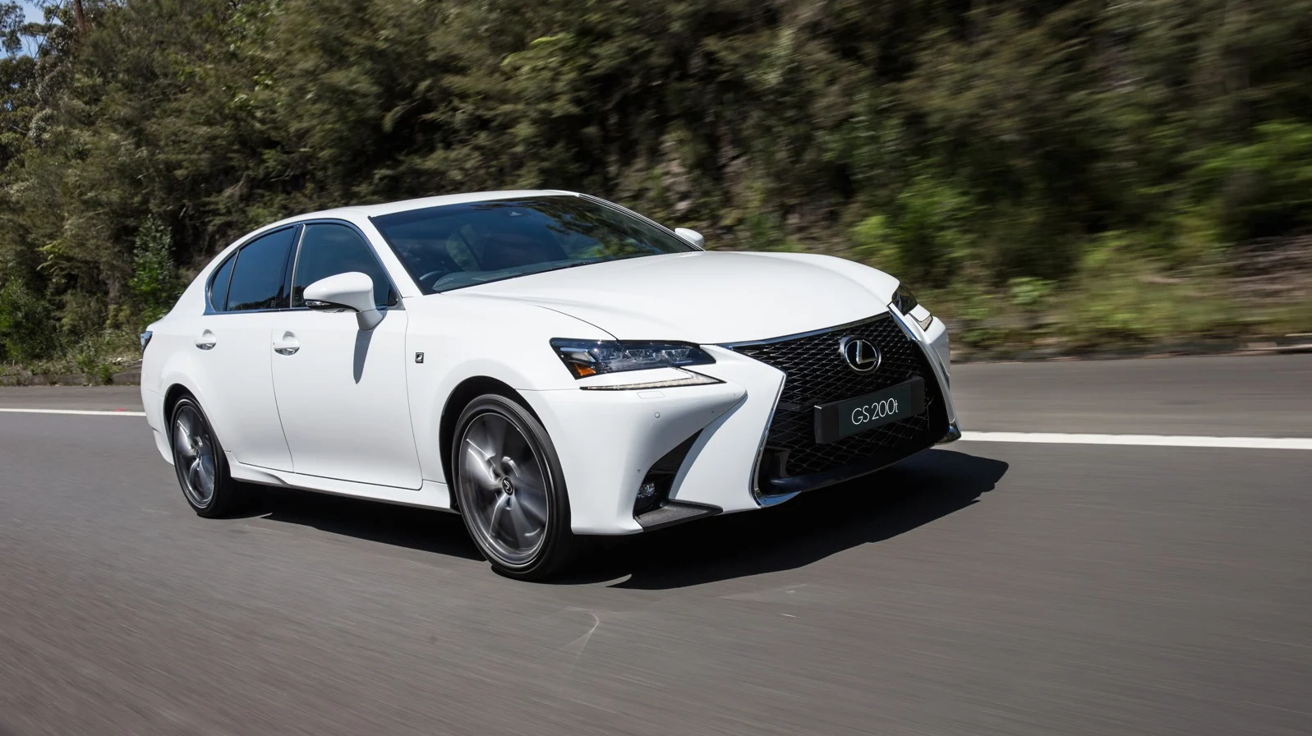
ROI Pooling - Problem
Resize the image by maintaining Aspect Ratio
Person
Car
Resize
Resize

Slide 29
SPP Feature Maps Outputs
ROI Projection
Resize to 680
SS / EB Crop
.
MODEL
ROI
561 x 255
.
Spatial Pyramid Pooling
Classification and Localization Model
Feature Map
n x m x 256
Resize the Image to high Resolution by maintaining aspect ratio
30 x 15 x 256

Slide 30
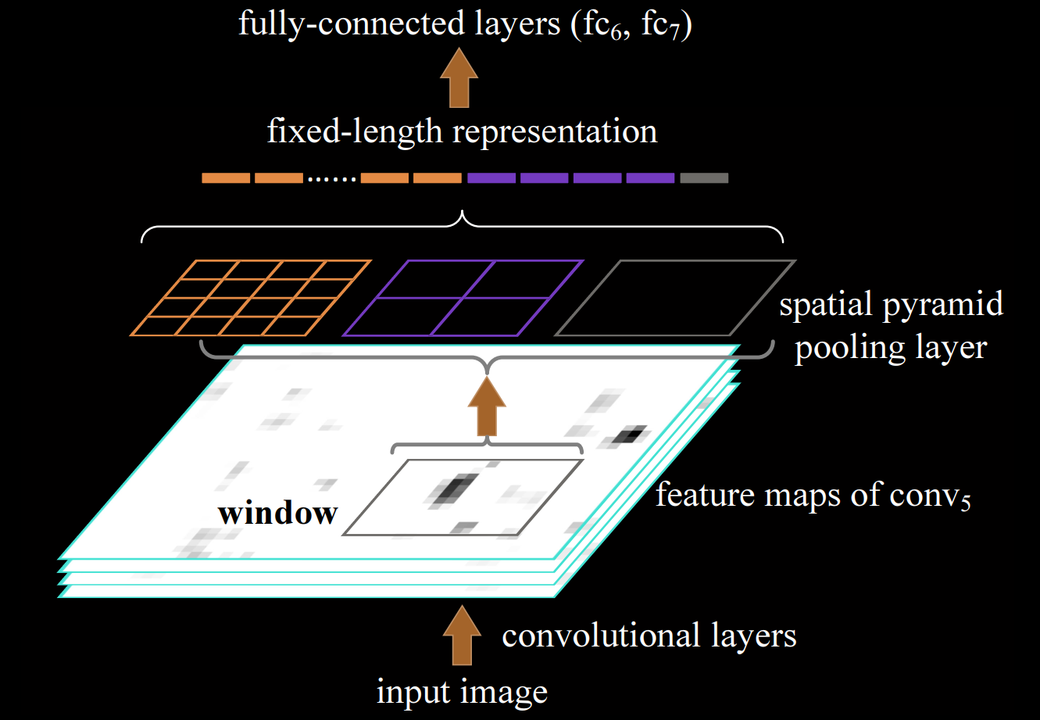
SPP Feature Maps Outputs - Research Paper
Feature Maps after resizing the input image to high Resolution
Credit: https://arxiv.org/abs/1406.4729

Slide 31
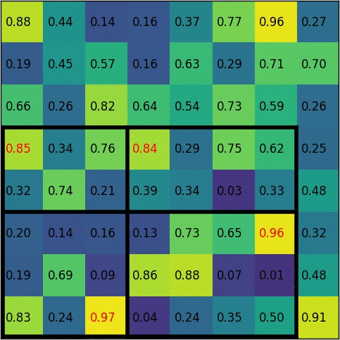

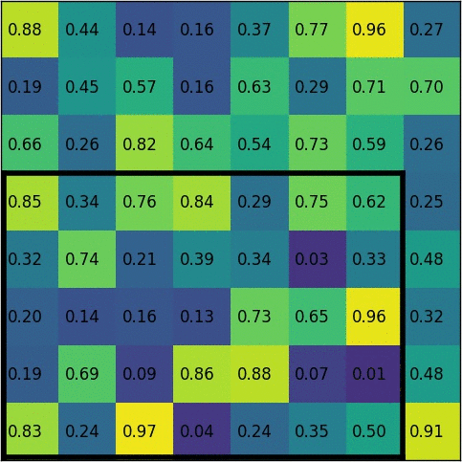
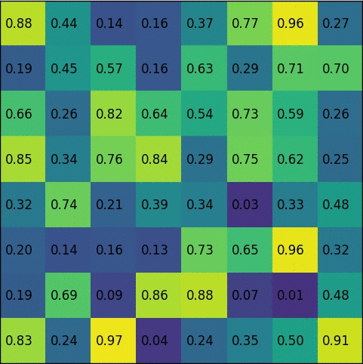
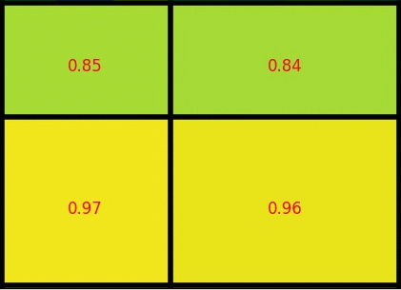
Spatial Pyramid Pooling
Illustration of SPP
Spatial Pyramid Pooling
Level 1 : 2x2 Grid
Extract Feature Map
Project Region Proposal
Max Pooling with multiple levels (e.g. 2x2 grid)
Fix size output of projected ROI
Feature Map
SPP
Feature Map
Fixed Size output
.
Fc1
Note: Size of FM is not necessary to be Even
Credit: https://deepsense.ai/region-of-interest-pooling-explained/

Slide 32
Spatial Pyramid Pooling Network for Object Detection
~ 2 K
Proposals
Region Proposals
Part 1
SS / EB
Fc1
Fine Tuning on Region Proposals using log loss [SOFTMAX]
(Training Only)
Fc2
ROI
Part 2
Fc1
Classification
Score Using
Linear SVM per class
MODEL
Fc2
VGG 16
C + 1 Class
Spatial Pyramid Pooling
Training
+
Testing
Feature Map
Fc1
Part 3
Crop
Classification and Localization Model
Bbox Regression
Warp
How to Project or translate ROI proposals onto feature maps ?
Subsampling and Resize the image by maintain aspect ration (ROI pooing)
Alternative of Warping ?
Spatial pyramid pooling

Slide 33
Spatial Pyramid Pooling Network for Object Detection
~ 2 K
Proposals
Region Proposals
SS / EB
ROI
MODEL
VGG 16
C + 1 Class
Spatial Pyramid Pooling
Feature Map
Fc1
Part 3
Classification and Localization Model
Bbox Regression
We already have Bbox crops available so we don’t need to train the Bbox reg to predict Bounding Box rather just need to finetune the Bounding Box by small delta.

Slide 34
Spatial Pyramid Pooling Network for Object Detection
Bbox Regression Finetuning
Ground Truth
Region Proposal
SS Crop
Predicted Bbox
.
.
.
Person
Predicted Bbox

Slide 35
Spatial Pyramid Pooling Network for Object Detection
Bbox Regression Training
.
Target
Offset
.
Predicted Offset
Ground Truth
Region Proposal
.
Predicted Bbox
This is also called Relative Bbox Training
Loss

Slide 36
Spatial Pyramid Pooling Network for Object Detection
Bbox Regression Training
.
d_{h}
F C 1
Ground Truth
d_{w}
Bbox Regression
.
Predicted Bbox
dx_{i ,} dy_{i ,} dh_{i ,} dw_{i}
F C 1
L₂ Loss Minimization
d_{y}
Bbox Regression
dx_{i ,} dy_{i ,} dh_{i ,} dw_{i}
d_{x}
^
L =
( x_{i} + dx_{i} - x_{i} ) ²
^ ^ ^ ^
+
x_{i ,} y_{i ,} h_{i ,} w_{i}
^
( y_{i} + dy_{i} - y_{i} ) ²
+
^
( h + dh_{i} - h_{i} ) ²
Loss
+
^
( h+ dw_{i} - h_{i} ) ²

Slide 37
Spatial Pyramid Pooling Network for Object Detection
~ 2 K
Proposals
~ 2000 computation per image
Region Proposals
Part 1
SS / EB
Fc1
Fine Tuning on Region Proposals using log loss [SOFTMAX]
(Training Only)
Fc2
1 computation per image
ROI
Part 2
Fc1
Classification
Score Using
Linear SVM per class
MODEL
Fc2
VGG 16
C + 1 Class
Spatial Pyramid Pooling
Training
+
Testing
Feature Map
Fc1
Part 3
Classification and Localization Model
Bbox Regression
How to Project or translate ROI proposals onto feature maps ?
Subsampling and Resize the image by maintain aspect ration (ROI pooing)
Alternative of Warping ?
Spatial pyramid pooling
Bbox Regression
L₂ loss minimization using small Deltas
ILSVRC 2014 : # 2nd Ranked in Object Detection

Slide 38

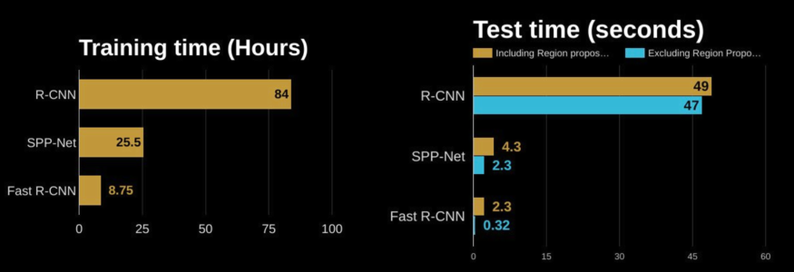
Spatial Pyramid Pooling Network for Object Detection - Experiment Details
4 level SPP is used:
Level₀ - 1x1 , Level₁ - 2x2, Level₂ - 3x3, Level₃ - 6x6
CNN process only one computational per image which reduced the time tremendously by sharing computational resources and weights
In the research paper, they further used Image Pyramid concepts (Resize the image to 480; 576; 688; 864; 1200) but It only increased the performance by 0.5 percent.
Image Pyramid
Advantages:
Not required to process 20k per image for CNN feature extractor.
No warping therefore no performance loss because of distorting of images.
Tremendous reduction in training and testing time.
.
.
.
No warping
Question
Do we need 4 levels of SPP. Why not only one level with 6x6 grids or higher ?

Slide 39
Fast Region Proposal Convolutional Neural Network - FRCNN
RCNN → SPPNet → FRCNN
Question
Do we need 4 levels of SPP. Why not only one level with 6x6 grids or higher ?
6 X 6
4 X 4
2 X 2
1 X 1

Slide 40
Fast Region Proposal Convolutional Neural Network - FRCNN
RCNN → SPPNet → FRCNN
~ 2 K
Proposals
Region Proposals
Part 1
SS / EB
Fc1
Fine Tuning on Region Proposals using log loss [SOFTMAX]
(Training Only)
Fc2
ROI
Part 2
Fc1
Classification
Score Using
Linear SVM per class
MODEL
Spatial Pyramid Pooling
Fc2
VGG 16
C + 1 Class
Training
+
Testing
Feature Map
Fc1
Part 3
Classification and Localization Model
Bbox Regression

Slide 41
Fast Region Proposal Convolutional Neural Network - FRCNN
RCNN → SPPNet → FRCNN
~ 2 K
Proposals
Region Proposals
Part 1
SS / EB
Fc1
Fine Tuning on Region Proposals using log loss [SOFTMAX]
(Training Only)
Fc2
S
P
P
1L
7x7
ROI
Part 2
Fc1
Classification
Score Using
Linear SVM per class
MODEL
Fc2
VGG 16
C + 1 Class
ROI
Pooling
Training
+
Testing
Feature Map
Fc1
Part 3
Only one level SPP with 7x7 grid named as ROI pooling layer.
Classification and Localization Model
Bbox Regression

Slide 42
Fast Region Proposal Convolutional Neural Network - FRCNN
RCNN → SPPNet → FRCNN
~ 2 K
Proposals
Region Proposals
Fc
Fc
SS / EB
Fine Tuning on Region Proposals using log loss [SOFTMAX]
(Training Only)
S
P
P
1L
7x7
ROI
MODEL
VGG 16
C + 1 Class
ROI
Pooling
Feature Map
Fc
Only one level SPP with 7x7 grid named as ROI pooling layer.
Using Sigmoid for both training and testing and remove SVM linear classifier makes more sense with no performance drop.
Classification and Localization Model
Bbox Regression

Slide 43
Fast Region Proposal Convolutional Neural Network - FRCNN
RCNN → SPPNet → FRCNN
~ 2 K
Proposals
3 Part → 1 Part Training
Region Proposals
Stage 1
Stage 2
SS / EB
S
P
P
1L
7x7
ROI
Fc
Fc
Fine Tuning on Region Proposals using log loss [SOFTMAX]
(Training Only)
MODEL
VGG 16
C + 1 Class
ROI
Pooling
Total Loss
Feature Map
Fc
Only one level SPP with 7x7 grid named as ROI pooling layer.
Using Sigmoid for both training and testing and remove SVM linear classifier makes more sense with no performance drop.
Using Smooth L1 Loss and Combining Classification and Reg Loss.
Classification and Localization Model
Bbox Regression
Smooth L1 Loss

Slide 44
Fast Region Proposal Convolutional Neural Network - FRCNN
RCNN → SPPNet → FRCNN
~ 2 K
Proposals
3 Part → 1 Part Training
Region Proposals
Stage 1
Stage 2
SS / EB
S
P
P
1L
7x7
ROI
Fc
Fc
Fine Tuning on Region Proposals using log loss [SOFTMAX]
(Training Only)
MODEL
VGG 16
C + 1 Class
Fc1
ROI
Pooling
Total Loss
Feature Map
Fc
Only one level SPP with 7x7 grid named as ROI pooling layer.
Using Sigmoid for both training and testing and remove SVM linear classifier makes more sense with no performance drop.
Using Smooth L1 Loss and Combining Classification and Reg Loss.
Classification and Localization Model
Bbox Regression
Smooth L1 Loss

Slide 45

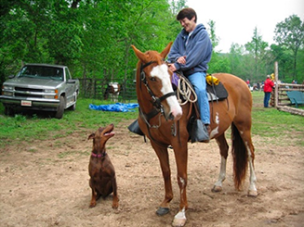
Fast Region Proposal Convolutional Neural Network - FRCNN
Log Loss + Smooth L1 Loss
RCNN → SPPNet → FRCNN
FC
Only one level SPP with 7x7 grid named as ROI pooling layer.
Using Sigmoid for both training and testing and remove SVM linear classifier makes more sense with no performance drop.
Using Smooth L1 Loss and Combining Classification and Reg Loss.
Finetune the CNN from 3rd layer as initial layers only learns basic shapes and edges alike feature.
ROI pooling
Trainable
SS Crops
Feature Map
Back
Propagation
Convnet
Advantages:
Only 1 part training also called Single Stage Training.
Significant reduction in training and testing time.
All the SPPNet advantages
Input Image

Slide 46
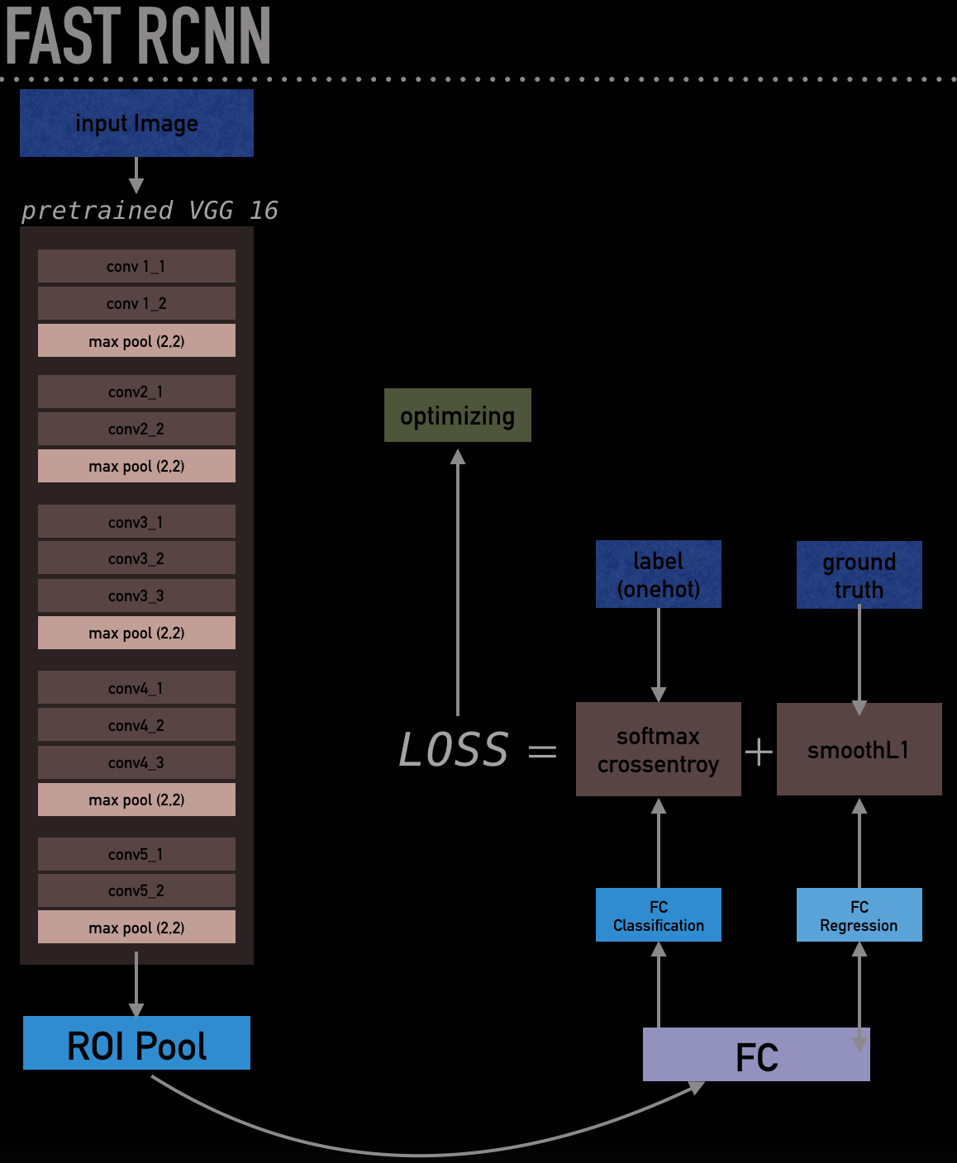
Significant reduction in training and testing time.
RCNN | FRCNN
1 X | 9 X
1 X | 150 - 213 X
SPNET | FRCNN
1 X | 3 X
1 X | 10 X
Training
Testing
FRCNN takes 0.3 sec per image to process (excluding region proposal time)
Credit: https://github.com/SoulDuck/fast_rcnn

Slide 47
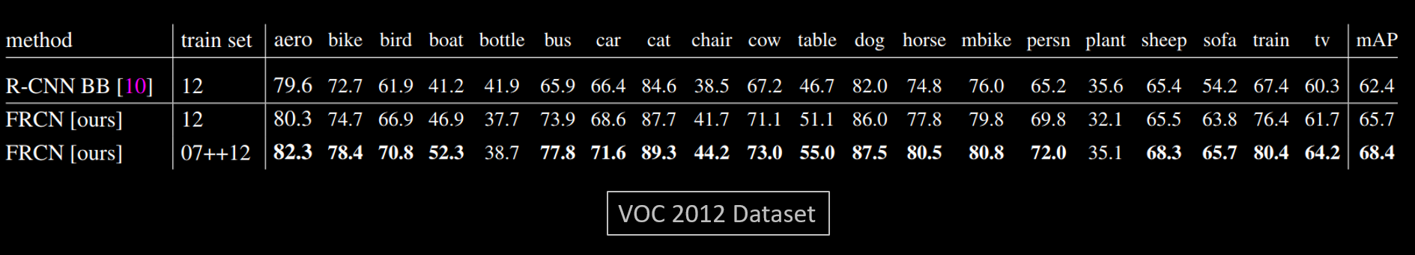
Fast Region Proposal Convolutional Neural Network - FRCNN
mAP Table
MAP increase from RCNN to FRCNN
≈ 62 %
≈ 66 %

Slide 48
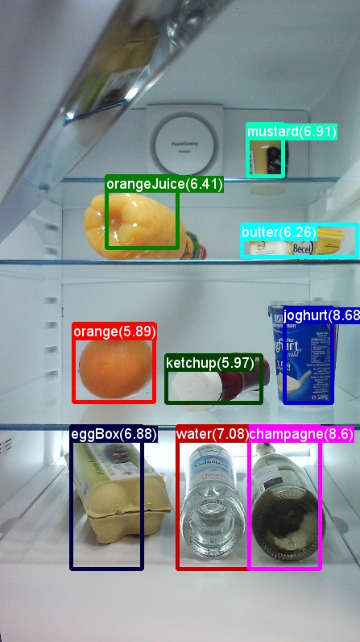
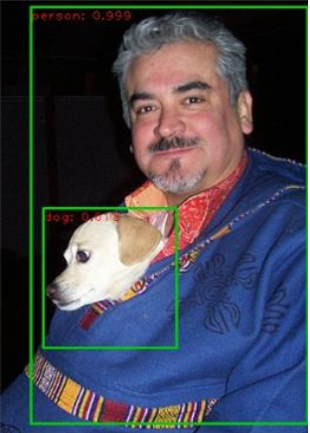
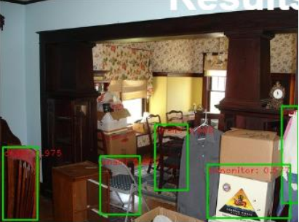
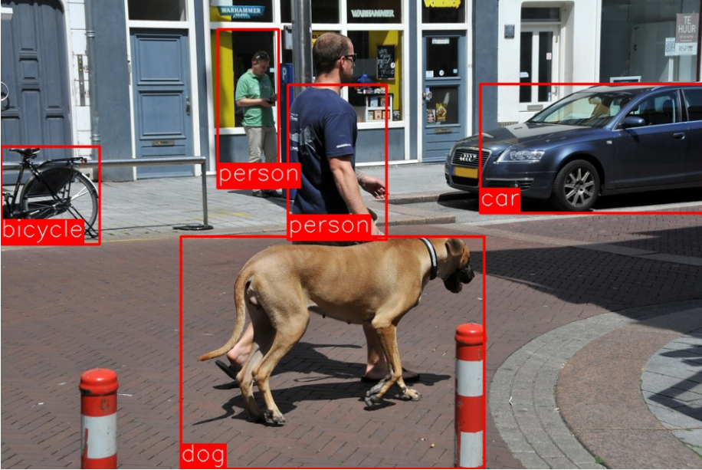
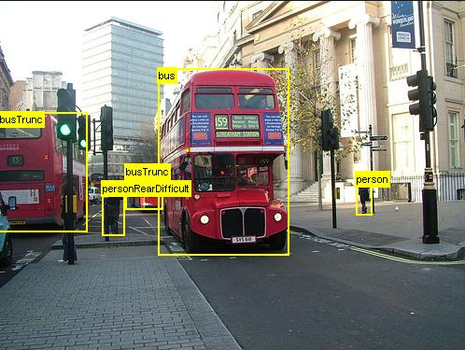
FRCNN – Compiled Results

Slide 49
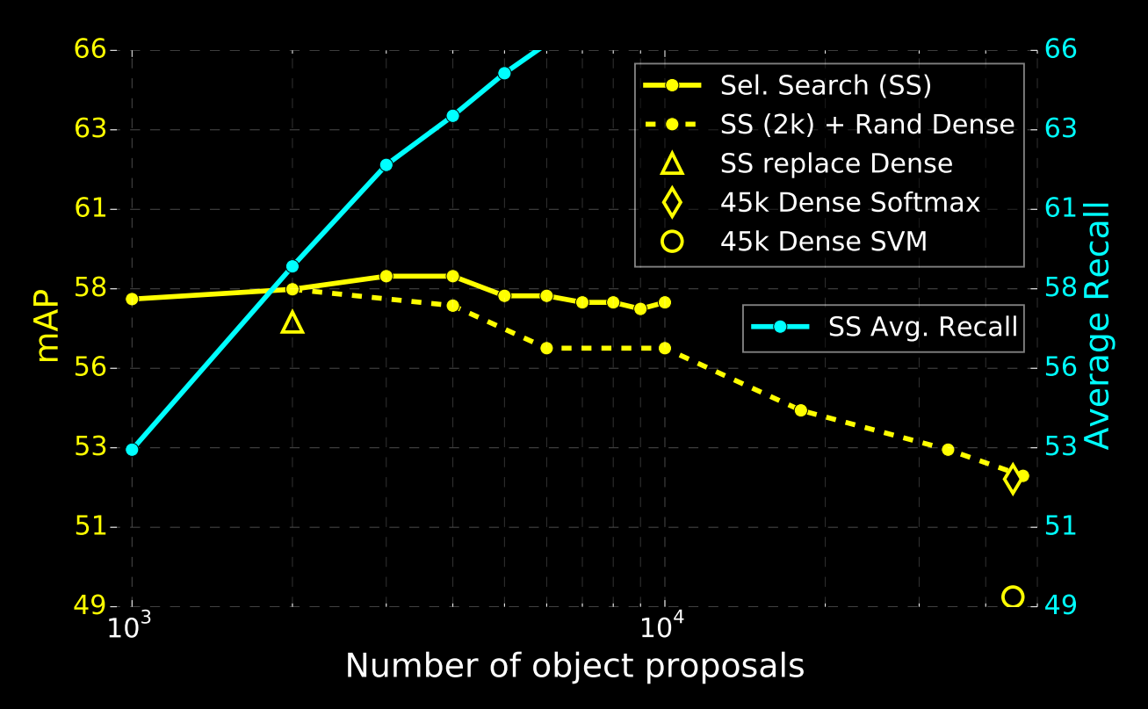
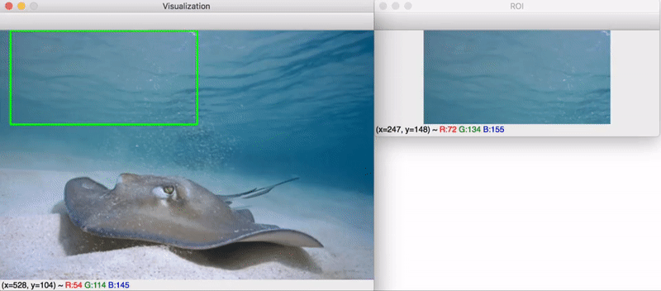
Validating the Reason of False Positives
Reason of having high False Positives
Very high number of candidates
Overfeat
Selective Search
VOC07 test mAP and AR for various proposal schemes
Overfeat
Source: Fast R-CNN Research Paper

Slide 50
FRCNN Improvement Scopes
Region Proposal Network is not learnable
E.g. SS or Edge Boxes is classical hard coded algo.
Although training in FRCNN is only 1 Stage but overall architecture is still 2 Stage Network
Classical (Region Proposal Network) + CNN.
Inference is still not very fast
2.3 sec per image (Including region proposal execution).
Paradigm
CNN
Based
End to End Training
Dense sampling Based
Multi Stage Training
Region Proposal Based
CNN
+
Classical
Based
(Overfeat)
(RCNN, SPPNET FRCNN)
Idea
If we could use some learnable CNN for Region Proposal Network, that would be best of both world.
END ☺

